Slide 1



Why we need a new welfare state revisited
Anton Hemerijck, Vu university amsterdam/London school of economics (LSE)
Cebes seminar
Rio de janeiro, 30 october

Slide 2
Outline
Three periods of European welfare state development
Welfare policy functions
Why We Need a New Welfare State? (2002)
Social investment: stocks, flows and buffers over the life course
Changing Welfare States (2013)
The Uses of Social Investment (2016) and Eurocrisis aftershocks

Slide 3
1. Three periods of european welfare state development
1. Great Depression (financial crisis and WWII - demand)
Search for Stability – ‘embedded liberalism’ 50/60
- Compulsory social insurance (Beveridge) as economic stabilization (Keynes) – ‘effective demand affinities’
- Baby Boom
2. Great Stagflation (real ecomomy crisis - supply)
Challenge of Flexibility – ‘institutional liberalisation’ 80/90
- EU single market/sound budgets/hard currency
- Last quarter baby boom enter labour market (women)
3. Great Recession (financial crisis – demand/supply)
Resilience Imperative
- Adaptive capacities
- Demographic ageing and international economic volatility

Slide 4
2. Welfare policy functions to mitigate economic insecurity and instability
‘Robin Hood’ redistribution
‘Piggy bank’ insurance
‘Social investment’ capacitation
Changing and interactive objectives (ameliorative, corrective, damage-limiting, problem-solving, technocratic)
Macro- and microeconomic efficiency (market failures)
Consumption smoothing
Risk-sharing
Labour market allocation
Relieving poverty
Reducing inequality
Addressing social exclusion
Making capitalism fit for liberal democracy

Slide 5
3. why we need a new welfare state (2002) resilience
Number supported by Average consumption per welfare provision welfare client
--------------------------- X -----------------------------------------
Number of workers Average production per worker
(hours worked)
Dominant focus on ‘numerator’ distributive side of equation in aging societies (them and us).
Long-term strength economy and welfare provision depending as much on social policy contribution to the (dynamic) productive ‘denominator’ side of the welfare equation.

Slide 6
“carrying capacity” welfare state and new risks to save pensions, we must invest in children!
Gender role change (endogenous service sector growth)
Family life course dynamics
Frequent labour market transitions and heterogeneous employment relations
Changing nature social risks as consequence (from ‘old’ to ‘new’)

Slide 7
Against Background inertia
Staying power passive male-breadwinner welfare legacy and reform opposition (intensifying ‘new’ social risks)
‘Big trade-off’ between equity and efficiency as default macroeconomic policy paradigm
Comparative welfare state research as the politics and sociology of static (cross-sectional) re-distribution, de- and re-commodification (outcomes) and retrenchment/expansion (process) in binary ways

Slide 8
social investment conjecture
Without a magic growth driver, sustainable employment best guarantee for growth and social cohesion in ageing European societies: social investments »crowd in« (high family-sensitive [flexicure] human capital utilization) as opposed to »crowding out« private economic initiative
Positive-sum complementarities for working families:
    Child-centered investment strategy
    Human capital investment push
    Active labour market policies and inclusion
    Reconciling work and family life
    Later and flexible retirement (and life long learning)
    Migration (circular) and integration through education and participation
    Minimum income support ‘buffers’ aligned to capacitating social service provision
    Health care: saving lives and costs (by quality learning through monitoring)

Slide 9
4. Social investment policy theory
Social investment policy aims at ‘preparing’ individuals, families and societies to respond to novel risks, rather than simply ‘repair’ damages after moments of economic or personal crisis. Welfare states in advanced economies are more than ever pressured to raise the quantity and quality of enabling or capacitating social services (family services, care and rehabilitation) alongside social security, not easily provided for by markets, to equip and assist people to surmount the increasingly uncertain hazards of the labor market and the life course they face.

Slide 10
21st century Social investment life course multiplier
Early childhood education and care
Employment
Exit age
Educational attainment
Dual earnership, worklife balance and fertility
Poverty protection and prevention

Slide 11
stock, flow and buffer complementarities
Social risks of the life course and the labor market have become less predictable – and therefore less insurable in a strict actuarial sense.
Raising the quality of human capital ‘stock’ over the life course from the young to the old (cumulative returns)
Easing the ‘flow’ of contemporary labour market transitions in line with (gendered) life course dynamics
Upkeeping/upgrading strong minimum-income universal safety nets as social (income) protection and macro-economic stabilization ‘buffers’ over risky transitions
Devil in detail “institutional complementarities”

Slide 12
5. Changing welfare states (2013):
Employment older workers

Slide 13
Female employment

Slide 14
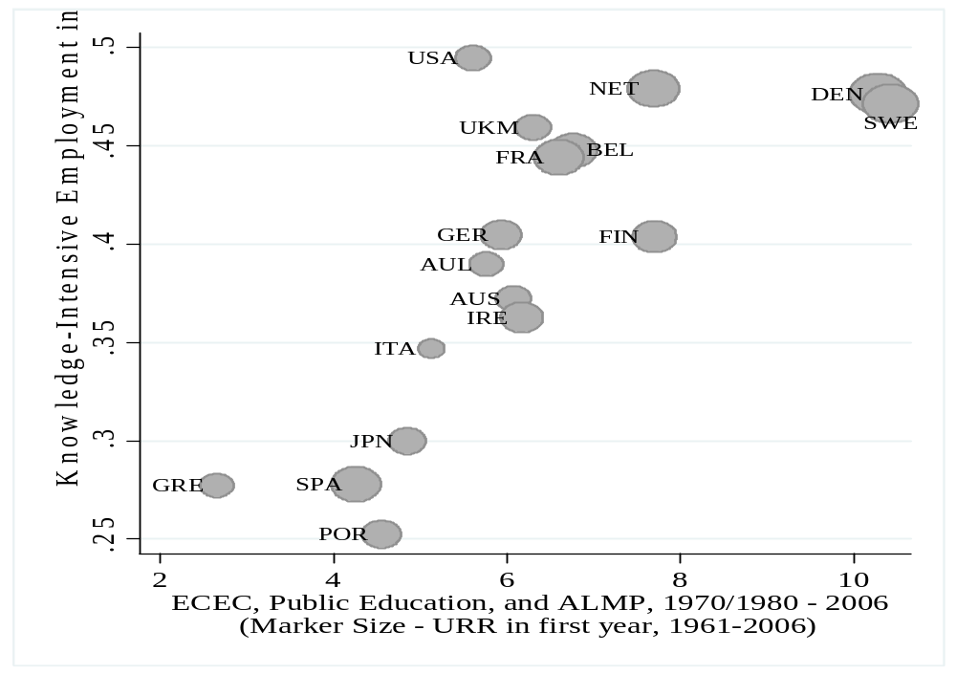
Boosting high quality employment

Slide 15
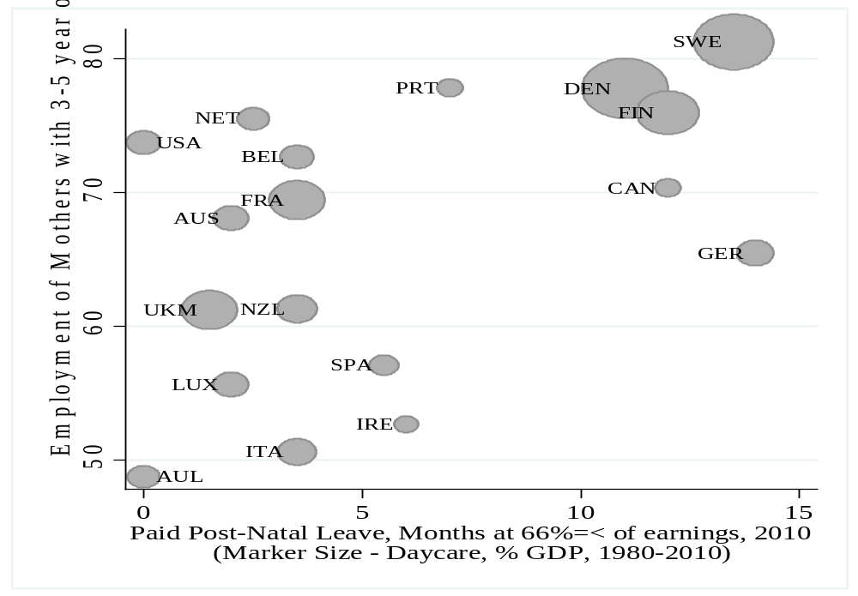
Boosting maternal employment

Slide 16
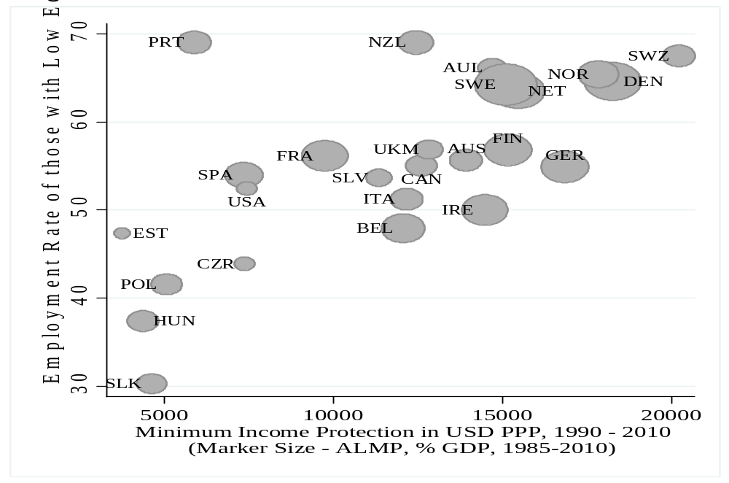
Boosting low skill employment

Slide 17
Childcare effort

Slide 18
FEMALE Employment rate and fertility rate

Slide 19
Preventing poverty - 2011

Slide 20
Changing welfare states: Employment rate and capacitating social spending - 2011

Slide 21
social investment policy effort throughout the crisis

Slide 22
DYNAMIC PERSPECTIVE

Slide 23
Comparative Life course radar

Slide 24
Life course radar Netherlands across time
Some figures:
PISA score 519 - higher than the OECD average of 497
Higher life expectancy 81 yrs (80 OECD average)

Slide 25
Good news and a concern
’Contingent convergence’ to more pronounced social investment policy portfolios. Three clusters: (1) Nordics, AT, NL, DE, SL; (2) UK, IRE, SP, HU, PO (policy diffusion); (3) GR, IT, BU, Baltics (not on the radar)
Increasing referential support (OECD), including the argument (also IMF) that inequality is bad for the economy through pre-emptive human capital and social mobility destruction in ageing societies.
Austerity drive creates a (unsustainable) two speed Europe: social investment quality competition up North versus minimal-welfare price competition down South and East Balkan
Predicament of intellectual inertia/cognitive capture: Social investment not (yet) positively embedded in E(M)U governance regime!

Slide 26
Two Competing theories of post-crisis welfare reform
Competing policy theories | Social austerity drift (axiomatic default theory) | Social Investment turn (empirically validated theory)
Policy problem | Cost containment (cuts) | Revenue raising (returns)
Policy imperative | Engineer “risk shift” to private sphere (Baumol cost disease) | Maximize employment in open economy (service productivity bonus)
Policy theory | Trade-off ‘equity and efficiency’ “crowding out” private economic initiative (efficient market hypotehis/welfare moral hazard | Social investments “crowd in” private initiative and competitiveness through higher employment and upskilling across life course (devil in detail)
Policy instruments | Labour market deregulation, privatization social services, and targeted minimum poverty protection ex post (inequality inevitable/fair in new economy) | Mitigate life (gender sensitive) cycle contingencies ex ante through human capital ‘stock’ upgrading, labour market ‘flow’ desegmentation, with strong universal safety net‘buffers’
Macro policy | Procyclical balanced budgets: Fiscal Compact, Troika, MoU, with sanctons (hysteresis best tackled through institutional liberalization) | Economic stabilization is more than fighting inflation and balanced budgets: Sailing - counter-cyclically - against wind) focus on inclusive growth
Theory state | Negative: One-size-fits-all take out market barriers through contracting out, while disciplining low-trust, rent-seeking ‘distributive coalitions’ (unions) | Positive: Diverse institutions both constraints and resources (public regarding social partners),‘productive coalitions’ and quality public services help mitigate Baumol disease
Political discourse | TINA (“European social model is dead” – Mario Draghi 2012) | Towards a capacitating, caring and dynamic Social Market Economy

Slide 27
6. four lessons from the eurocrisis and two conclusions
Asymmetric competition (social imbalances, dramatic (youth) employment) undermines viability of EMU – macro-economic lesson
Countries do matter – welfare policy lesson
    - Active unsegmented and family-friendly welfare state do better
    - Problematic policy legacies (pension-bias/dualization/familialist) exposed
Indiscriminate fiscal austerity undermines budgetary consolidation (problem countries) – crisis management lesson
Frontloading austerity (and EU mismanagement) breeding ground for xenophobia – political lesson
      E(M)U fiscal federalism unavoidable
      Social investment can no longer be dismissed as ‘fair weather’ policy

Slide 28
What do europeans want?
A decent job (both men and women)
Raising a family of 2,3 children (effective fertility 1,6)
A good education for their children
Social investment holds the best ‘track record’!!

Slide 29
Political dilemma
Political dilemma: social investment anathema to two conservative reflexes: the Eurocrisis austerity reflex (Merkel and Draghi) en anti-EU national welfare chauvinism (Le Pen en Wilders).
Unlearning most difficult aspect in processes of (evolutionary) paradigm change!

